Slide 1
Player Experience

Slide 2
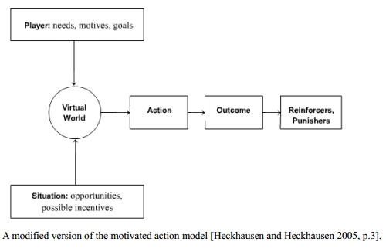

Motivated Action Model

Slide 3

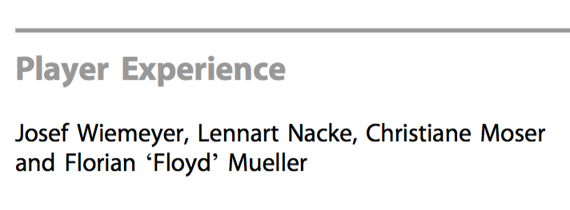

Slide 4

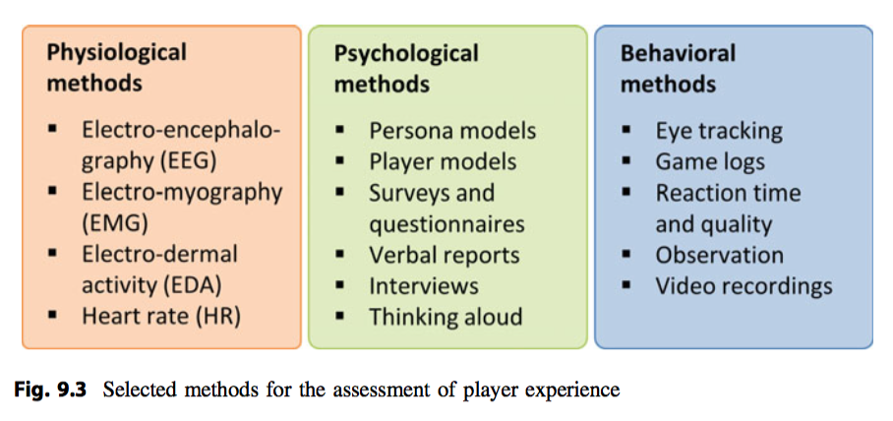
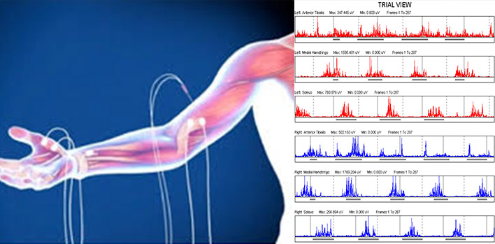
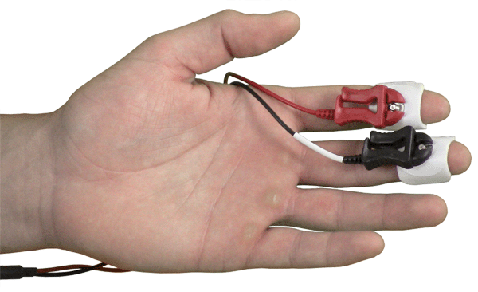

Slide 5
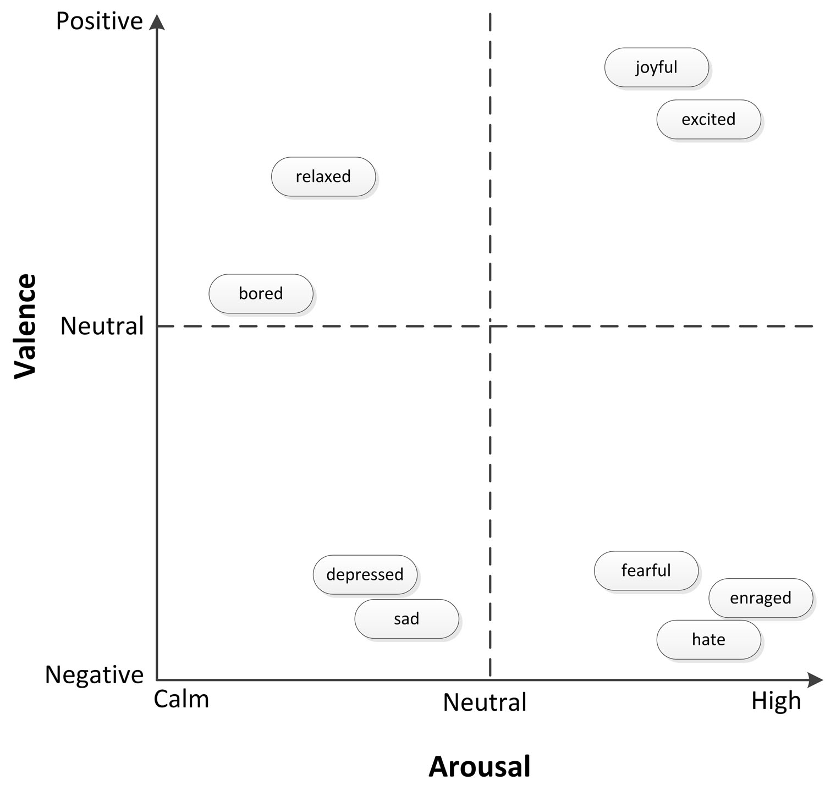
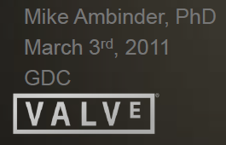
HEART RATE
Index of arousal
Cheap
Easy to measure
Familiar
Prone to movement artifacts
Delayed onset to stimuli
Difficult to determine valence
The valence of the emotion, whether it is a positive or negative experience, is hard to measure.

Slide 6
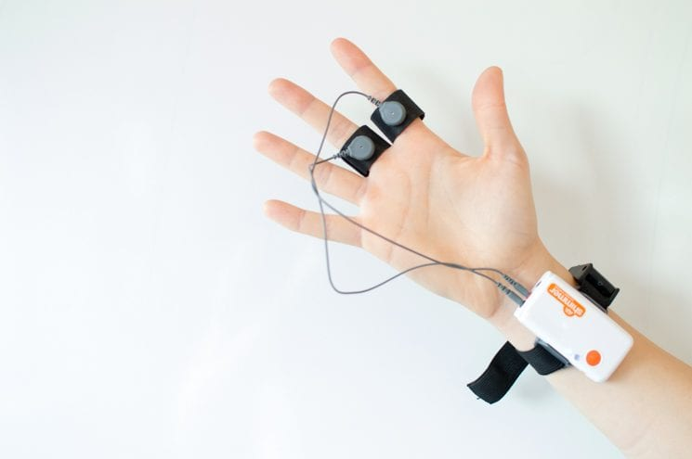
ELECTRODERMAL ACTIVITY
Index of arousal
Minimal lag to stimuli
Cheap
Robust to movement
Lots of measurement sites
Difficult to associate eliciting events
Difficult to determine valence
Range is variable across subjects

Slide 8
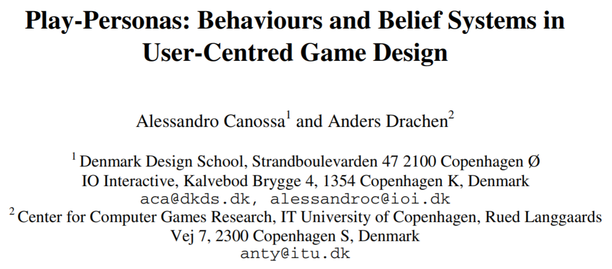
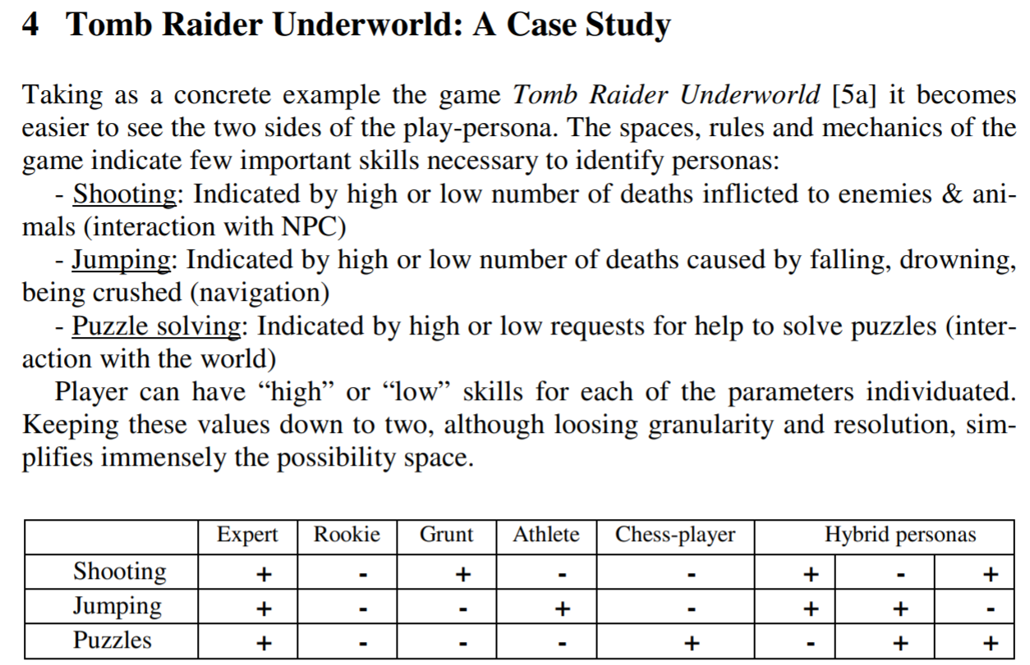

Slide 9
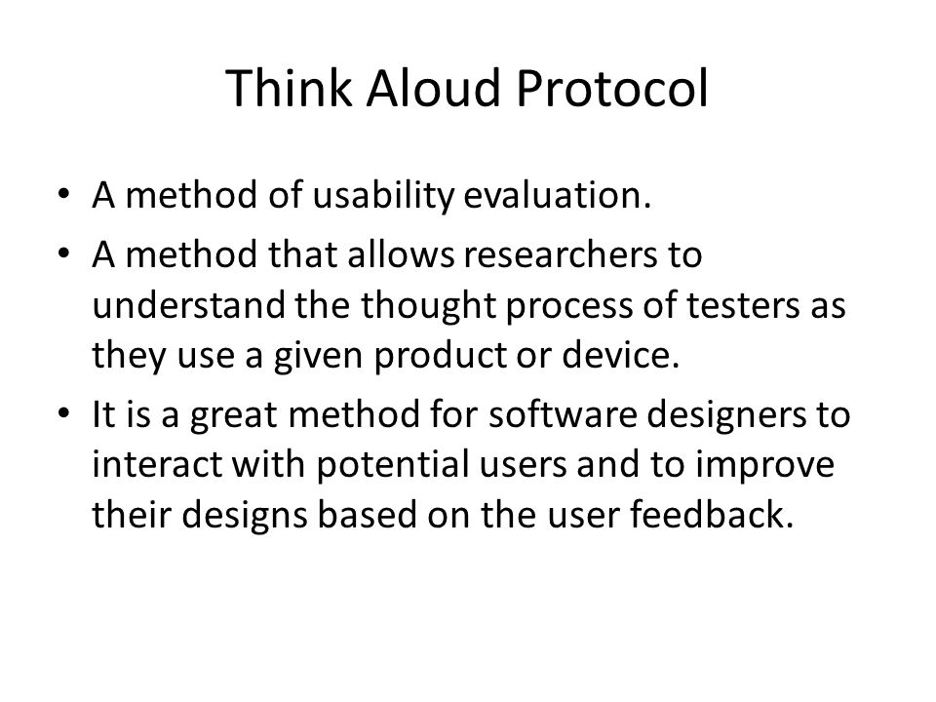

Slide 10
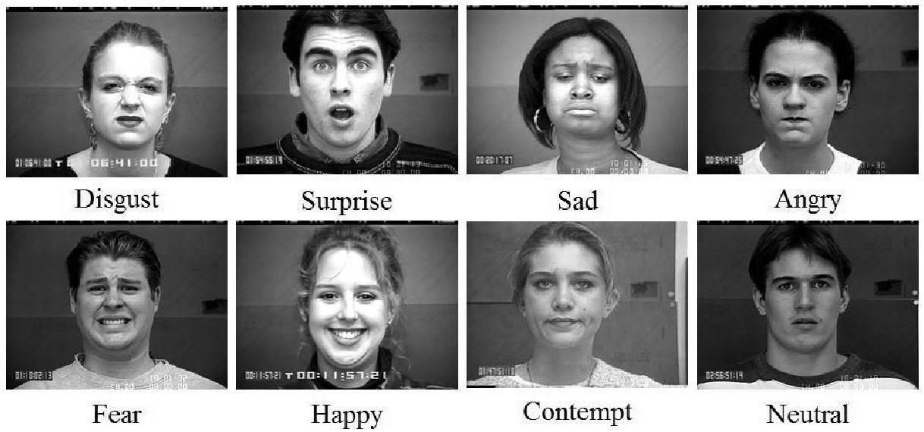
FACIAL EXPRESSIONS
Index of valence
Index of arousal
Measures instantaneous responses
Can be intrusive
Expensive
Subject to bias
Requires training

Slide 11
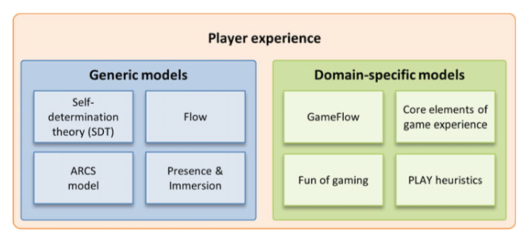

Slide 12

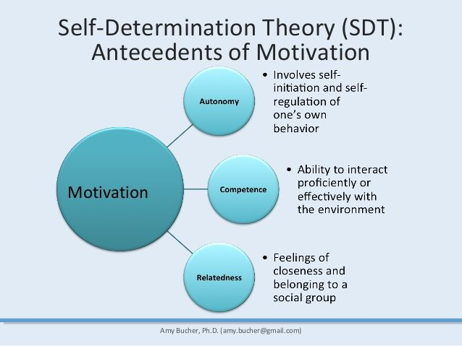



Slide 13

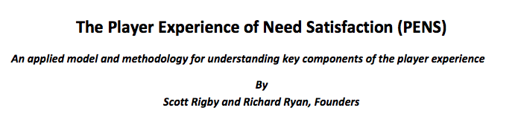
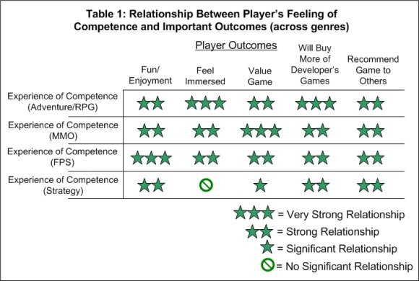
Competence = Feeling effective in what you are doing, related with challenges and difficulty, competitive gameplay Autonomy = Feeling that you have the freedom to choose and your actions matter, choice and consequence games Relatedness = Feeling that you connect with others, social relationships, cooperative gameplay

Slide 14

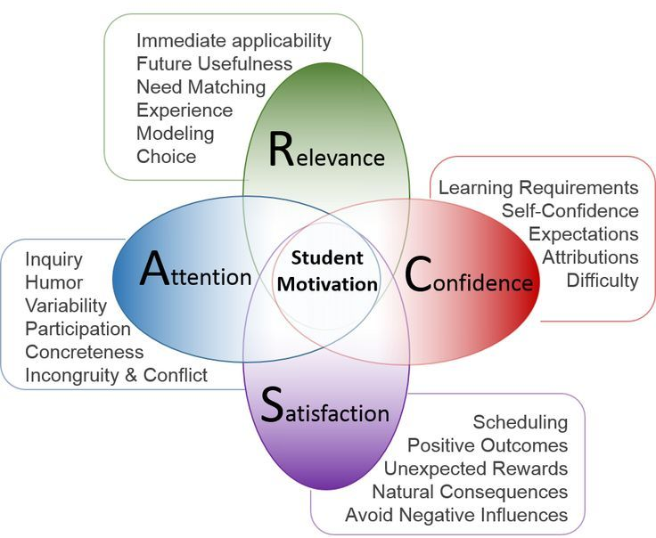


Slide 15
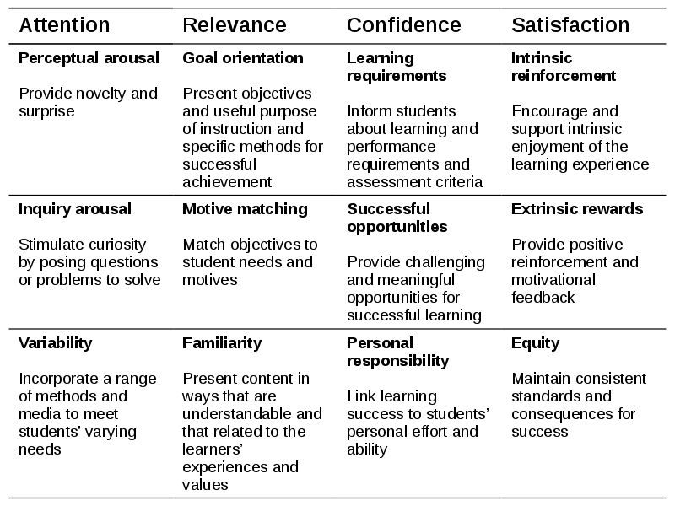

Slide 16

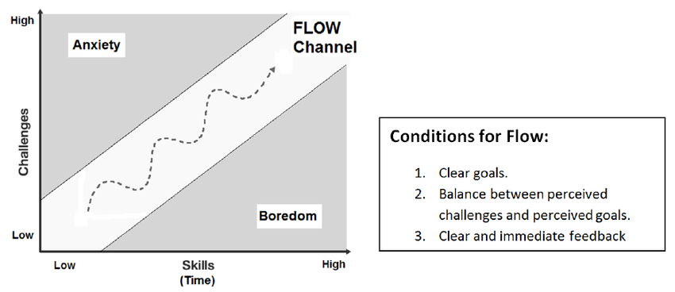


Slide 17
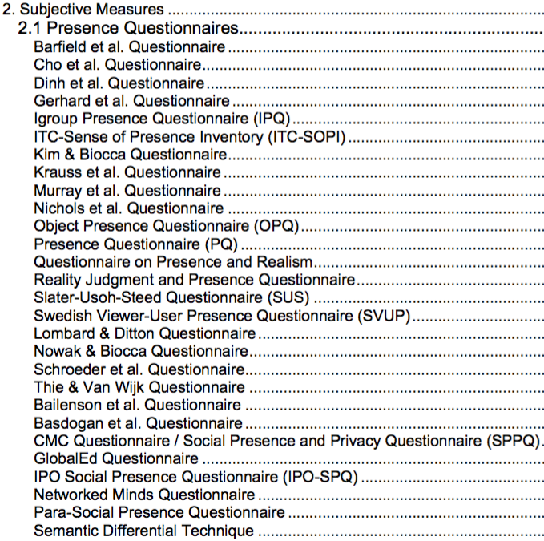
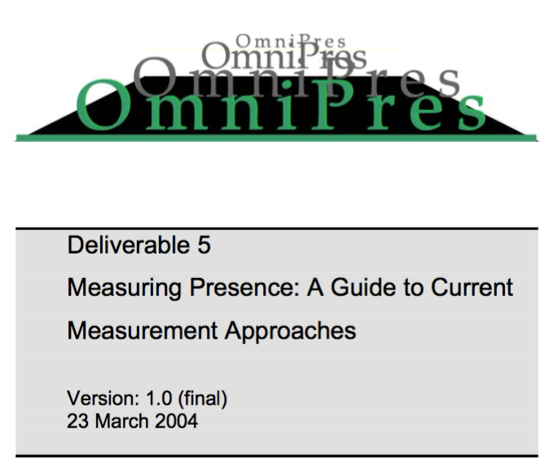

Slide 18
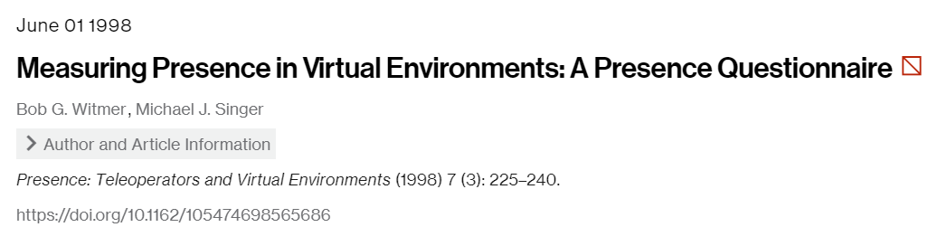
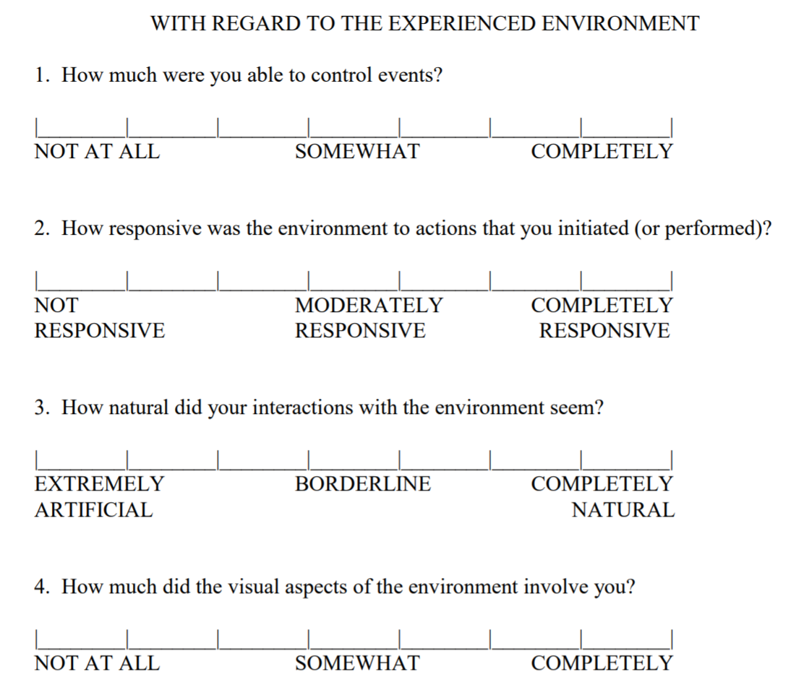

Slide 20
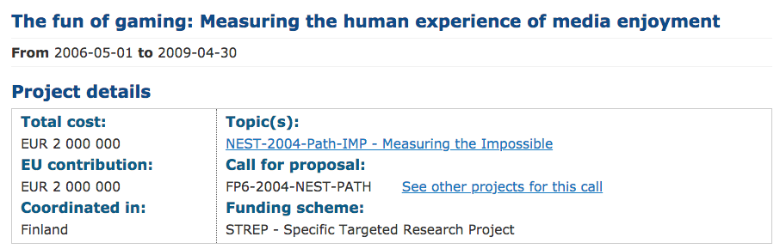

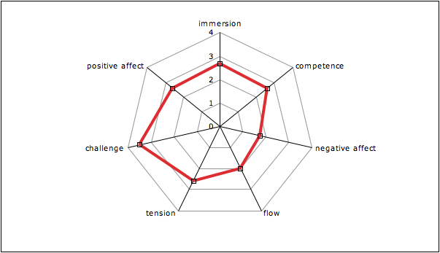
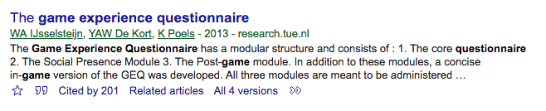


Slide 21
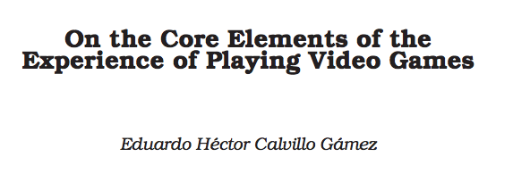
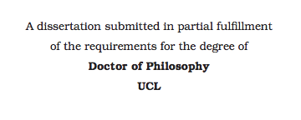
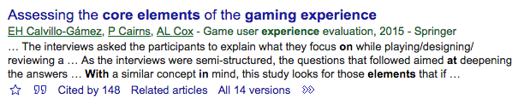
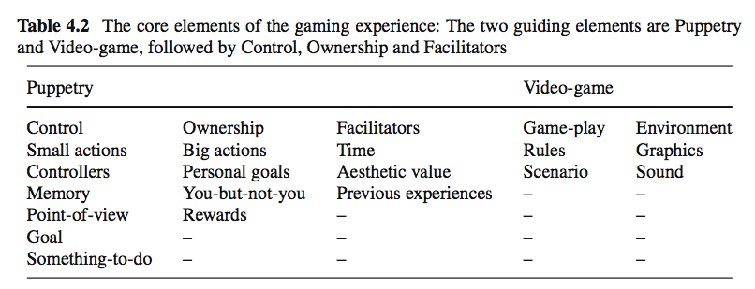


Slide 22
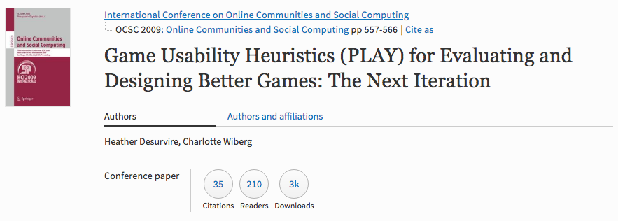
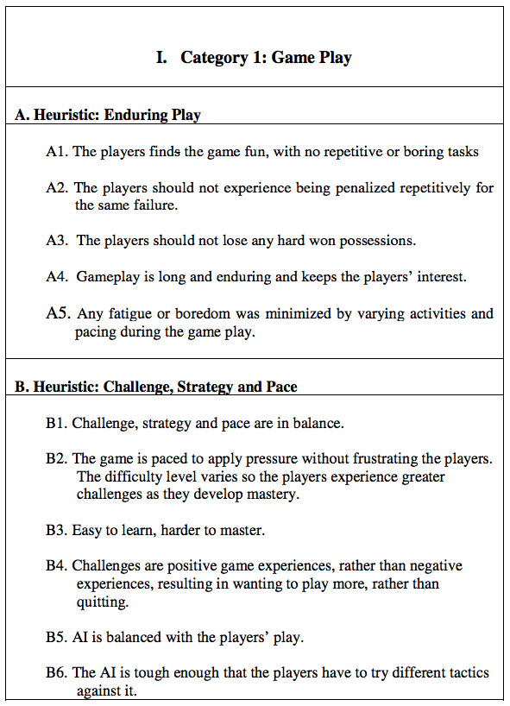

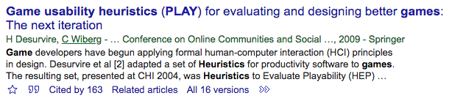
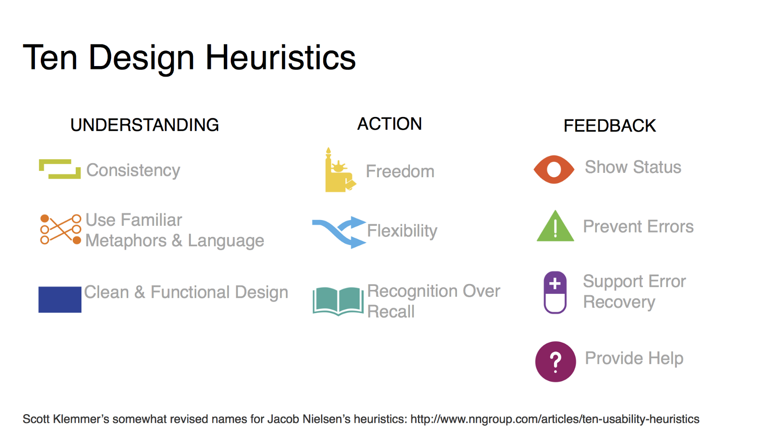

Slide 23

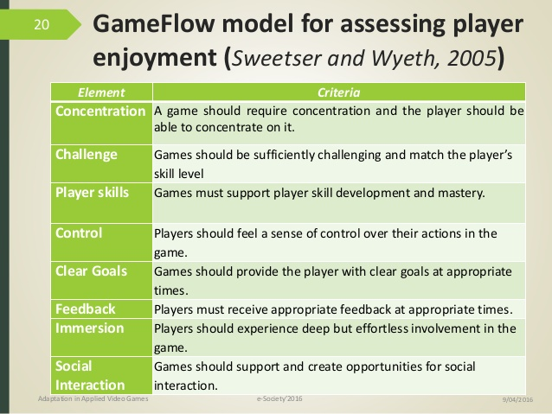
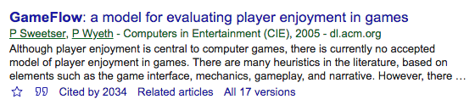

Slide 24

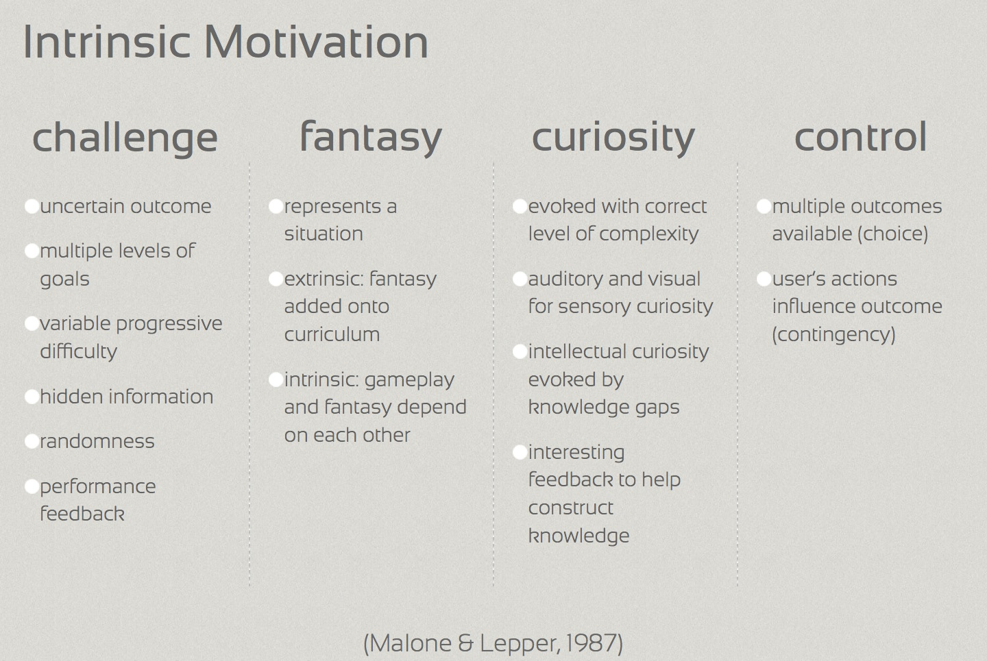
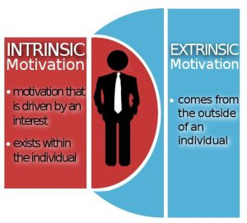

Slide 25
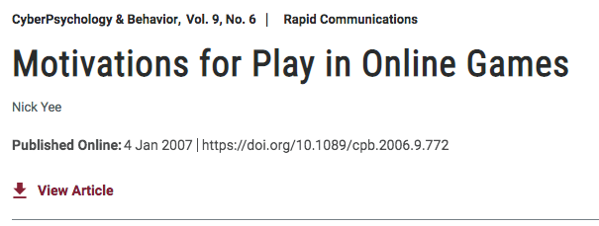

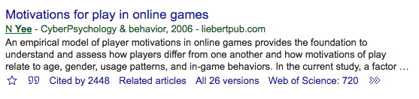
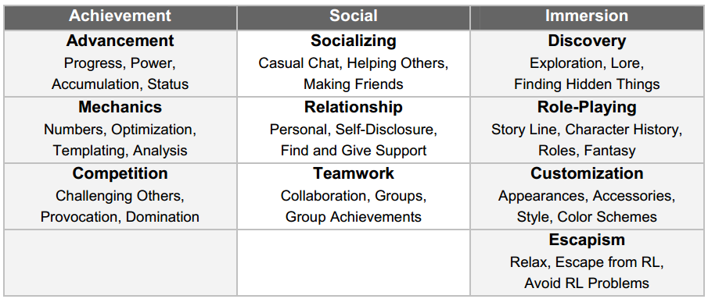

Slide 26
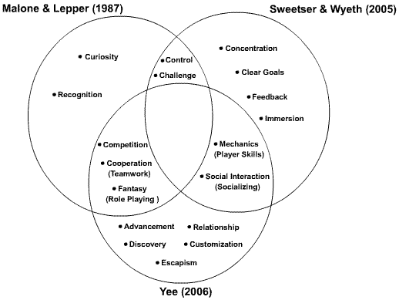
Motivation

Slide 27
GUR (Game User Research)

Slide 28
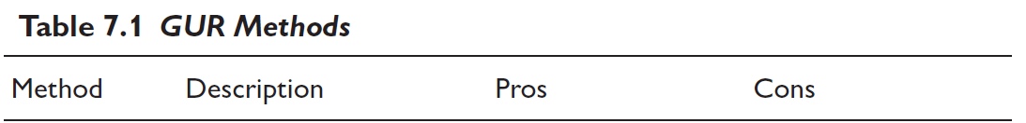
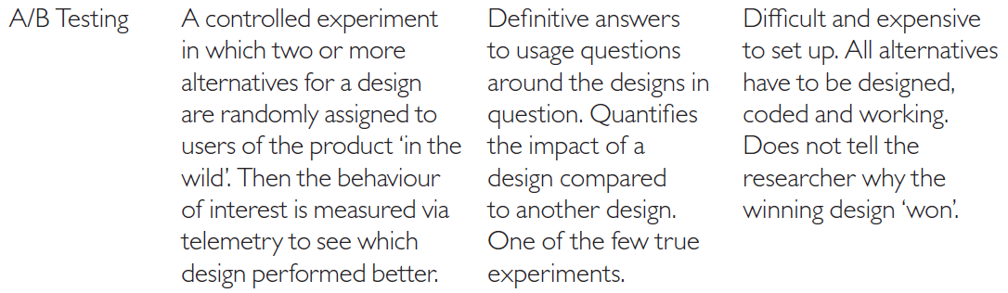
GUR Methods
Game telemetry is data logged from clients or servers about how players play games, or conversely about how the game client itself responds to player behavior.

Slide 29
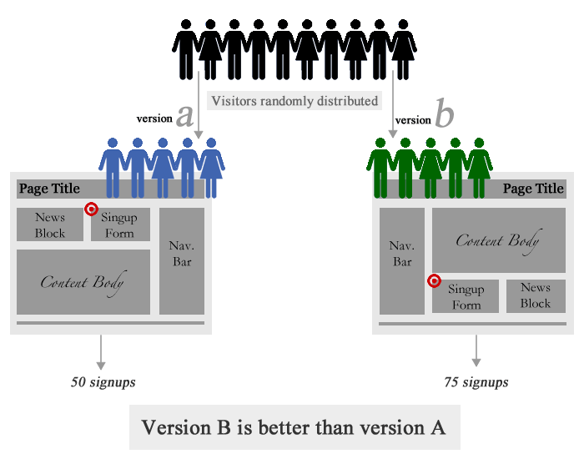

Slide 30
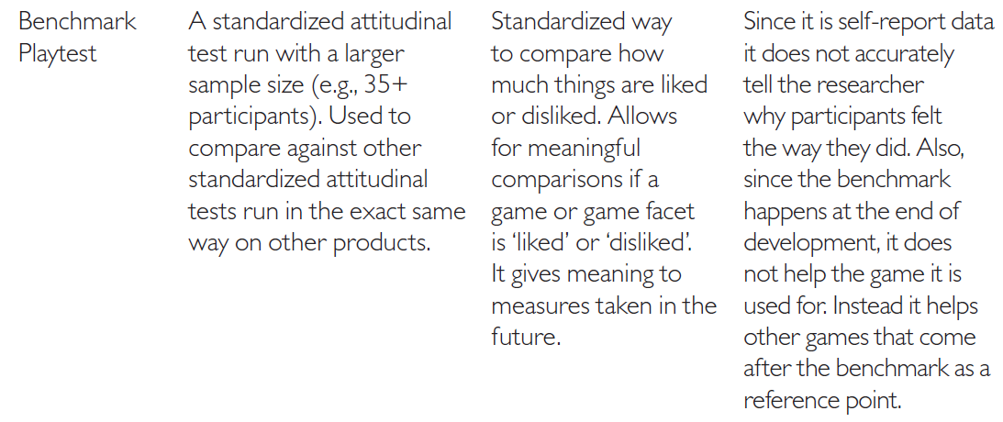
GUR Methods

Slide 31
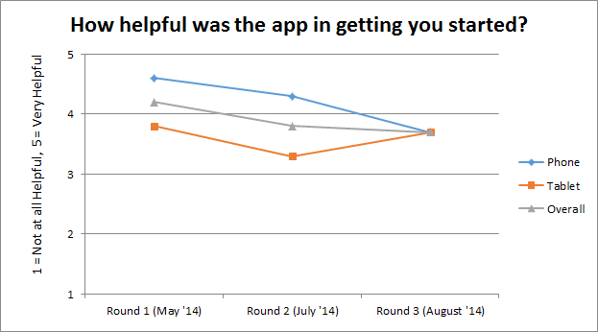

Slide 32
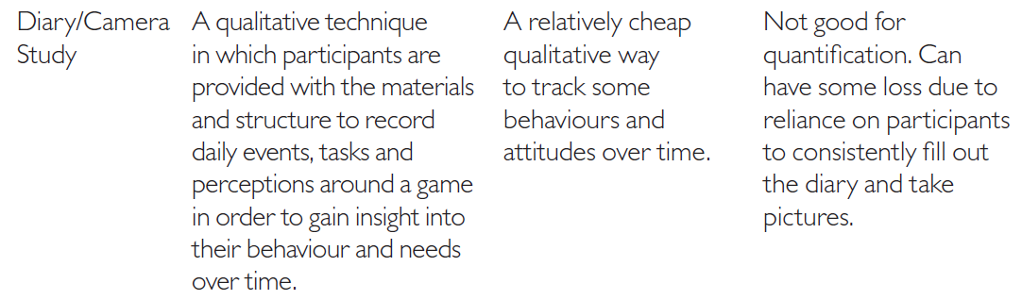
GUR Methods

Slide 33
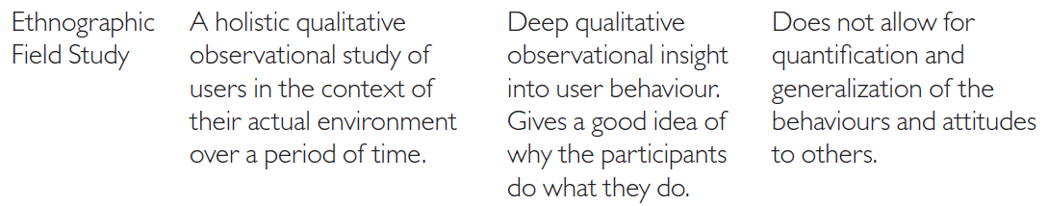
GUR Methods

Slide 34
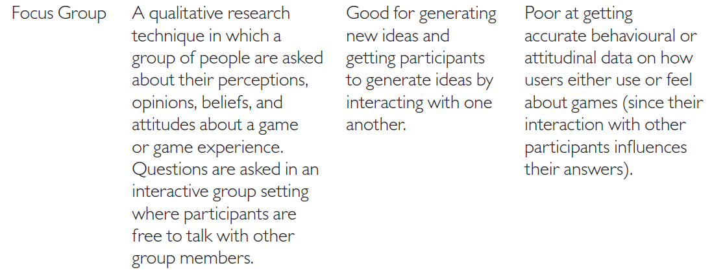
GUR Methods

Slide 35

GUR Methods

Slide 36

GUR Methods

Slide 37



Slide 38


Slide 39


Slide 40
Measuring the Game Experience

Slide 41



Slide 42


Slide 43


Slide 44


Slide 45



Slide 46


Slide 47



Slide 48


Slide 49
Game User Experience Satisfaction Scale GUESS

Slide 50


Slide 51


Slide 52


Slide 53


Slide 54


Slide 55


Slide 56


Slide 57


Slide 58


Slide 59


Slide 60


Slide 61


Slide 62


Slide 63


Slide 64


Slide 65
Table 15.2: Mean and standard deviations of seven GUESS factors (The highest means were highlighted with green while the lowest means were highlighted with red for each factor), N=121
Game No* | Audio Aesthetics |  | Creative Freedom |  | Enjoyment |  | Narrative |  | Play Engrossment |  | Usability Playability |  | Visual Aesthetics
 | M | Std | M | Std | M | Std | M | Std | M | Std | M | Std | M | Std
1 | 23,28 | 4,52 | 32,76 | 7,72 | 24,59 | 4,13 | 25,44 | 6,17 | 30,07 | 8,90 | 55,61 | 6,28 | 17,33 | 3,63
2 | 24,22 | 3,32 | 33,80 | 7,79 | 25,36 | 4,59 | 30,23 | 7,13 | 33,66 | 10,77 | 53,26 | 9,11 | 18,60 | 2,84
3 | 22,63 | 4,18 | 29,06 | 8,74 | 23,56 | 5,05 | 24,17 | 8,06 | 30,76 | 10,53 | 47,3 | 10,94 | 17,07 | 3,55
4 | 25,11 | 3,61 | 39,01 | 7,68 | 26,75 | 3,96 | 31,30 | 7,30 | 36,75 | 10,09 | 55,75 | 8,04 | 18,49 | 3,43
5 | 25,17 | 3,83 | 34,46 | 8,37 | 24,31 | 5,06 | 31,72 | 7,77 | 34,22 | 11,30 | 48,94 | 11,39 | 19,28 | 2,36
6 | 22,87 | 3,80 | 34,75 | 8,34 | 24,80 | 5,05 | 30,22 | 6,89 | 32,67 | 10,49 | 55,21 | 8,62 | 17,10 | 3,42
Total | 23,83 | 3,99 | 33,74 | 8,61 | 24,90 | 4,72 | 28,58 | 7,80 | 32,92 | 10,53 | 52,62 | 9,74 | 17,95 | 3,34
*1. Super Mario Odyssey, 2. Control, 3. Sniper Elite 4, 4. Contrast, 5. Hellblade: Senua’s Sacrifice, 6. Council.

Slide 66
Player Experience

Slide 67
Summary
Generic models of player experience
Domain-specific models of player experience
Questionnaires that measure player experience
Game User Experience Satisfaction Scale (GUESS)

